Slide 1
120GHz Imaging Radar
Team 40:
Huyen Vy Pham: Team lead
Aaron McCarville: Lead hardware design
Noah Gaffney: Hardware design and testing
Gunnar Hageman: Embedded programming
Benjamin Podjenski: Software programming
Client:
Professor Mohammad Tayeb Al Qaseer
Advisor:
Professor Mohammad Tayeb Al Qaseer

Slide 2
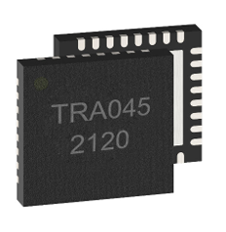
Project Vision
Project goal: It is to build a 120 GHz millimeter wave (mm-wave) imaging radar. The system will be based on TRA_120_045 radar chip. There are two subsystems in the radar:
RF circuit (radar IC and phased-locked-loop (PLL) circuitry).
ADC circuit with FPGA
A GUI
Usage:
It is mainly used for the Non-destructive Evaluation do object imaging and flaw detection inside of model.
Approach:
Building and testing two subsystems (RF and ADC boards) separately.
Programming the Alchitry Au to control peripheral IC's through SPI.
Configuring the Alchitry Au to send ADC data to Host PC via USB.
Building a PC application for user to communicate to the system.
Testing the system as a whole for functionality.
Using the system to conduct radar imaging experiments in the microwave lab at CNDE.

Slide 3
Conceptual/Visual Sketch
RF Board: Radar IC and PLL circuitry
FPGA Board: SPI, UART, and FTDI/ USB communication
Control signal
User Interface: Data transfer and display; control signal
Control signal
Data
ADC Board: Low Pass Filter, Amplifier, and ADC
Control Signal
Data
Data

Slide 4
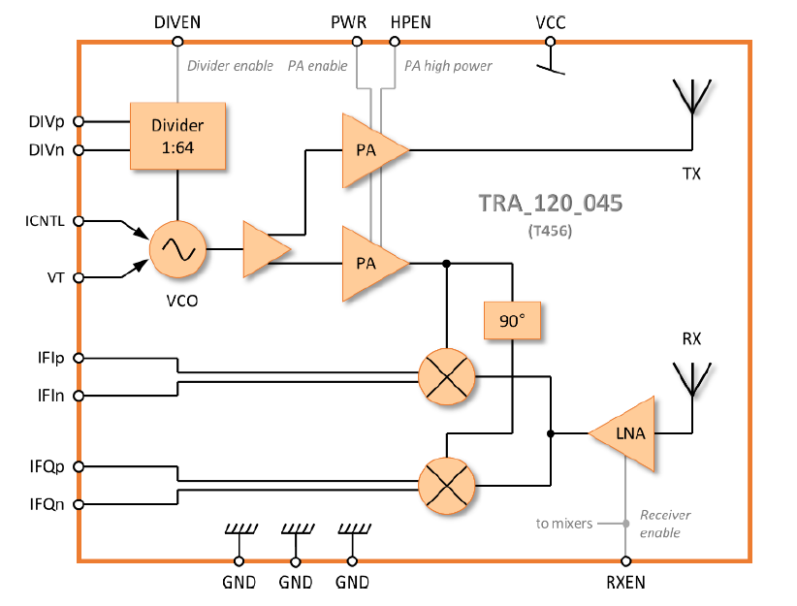
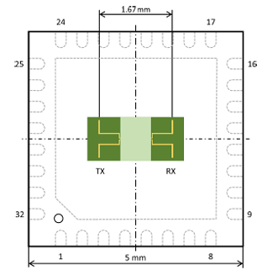
System Design
TRA 045 chip
Antenna on chip
Internal diagram

Slide 5
System Design
Detailed design (components/modules design) for RF Board – The Phase Lock Loop circuitry
Phase Lock Loop circuitry
Reference frequency
X
Low Pass filter
VCO
RF frequency
N Divider

Slide 6
System Design
Detailed design (components/modules design) for ADC Board
IFIp
ADC
IFI
IFIn
IFQp
ADC
IFQ
IFQn
Notes:
Should talk about the cutoff frequency of the LPF and then the spec for ADC

Slide 7
System Design
Detailed design (components/modules design) for Signal Path
RF Board
Alchitry Au
Host PC
SPI
ARTIX 7
GUI
Control signal
UART
IFI and IFQ data / Control
FTDI Chip
ADC Board
Control signal
JTAG
IFI and IFQ data
USB 2.0
Notes:
Should talk about the cutoff frequency of the LPF and then the spec for ADC

Slide 8
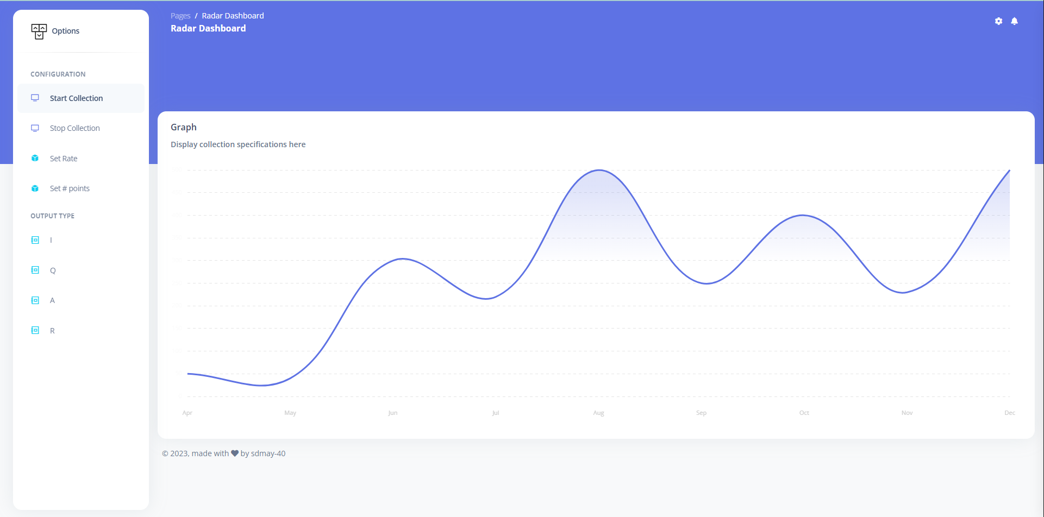
System Design
User Interface Prototype
FPGA
Control signal
Raw Data (IFI and IFQ)

Slide 9
System Design
HW/SW platforms, technology, frameworks, standards
GUI software:
Front-end: Django Framework.
Webpage Hosting: Raspberry Pi using an Apache webserver.
Embedded Programming: Xilinx platform, Vivado (Hardware) and Vitis (Software).
Communication between PC and FPGA: FTDI.
RF and ADC board: KiCad.
Lens Modeling: CST software.
Testing: Spectrum Analyzer.

Slide 10
Project Plan
Task Decomposition:
RF board (based on Evaluation bard)
ADC Board PCB and Schematic
FPGA Programming
ADC Board
Connecting the Data Sequencing with RF subsystem and FPGA and GUI Programming
FPGA Research and Learning
GUI Programming
Lens Modeling

Slide 11
Project Plan – Schedule/Milestones
Milestone | Task | Completion | Expected Completion Date
Radar Board Design |  |  | 10/23/2023
 | Schematic Design | 100% | 9/23/2023
 | Layout Design | 100% | 10/23/2023
Radar Board Testing |  | 100% | 1/26/2024
 | PLL on the board to be locked at a single frequency, and it is detected by Spectrum Analyzer | 100% | 11/10/2023
 | PLL on the board can sweep a range of frequency and can be detected by Spectrum Analyzer | 100% | 11/30/2023
 | Conducting imaging using the Radar Board with NIDAQ | 100% | 1/26/2024

Slide 12
Project Plan – Schedule/Milestones
Milestone | Task | Completion | Expected Completion Date
ADC Board Design |  | 100% | 2/9/2024
 | Schematic Design | 100% | 12/6/2023
 | Layout Design | 100% | 2/9/2024
ADC Board Testing |  |  | 3/9/2024
 | Testing the functionality: A signal generator will send a voltage sine wave is sent to the ADC board. The raw ADC data is collected by the FPGA and is plotted by the host to be compared to the original voltage sine wave | 30%
Integrating the ADC board and RF board |  | 0% | 3/23/2024

Slide 13
Project Plan – Schedule/Milestones
Milestone | Task | Completion | Expected Completion Date
FPGA programing |  |  | 3/31/2024
 | Sending and echoing commands through UART | 100% | 2/10/2024
 | Communicating with the GUI through UART | 100% | 2/17/2024
 | Sending and echoing commands through SPI | 30% | 3/10/2024
 | Sending commands to program PLL through SPI |  | 3/23/2023
 | Sending commands to program ADC through SPI |  | 3/31/2024
 | Sending commands to program the Amplifier |  | 3/31/2024

Slide 14
Project Plan – Schedule/Milestones
Milestone | Task | Completion | Expected Completion Date
GUI programing |  |  | 3/31/2024
 | Communicating with the FPGA through UART | 100% | 2/10/2024
 | Sending control data to PLL to FPGA |  | 3/23/2024
 | Receiving data from the DAC through FPGA |  | 3/31/2024
 | Live updating the data on the GUI |  | 3/23/2024
 | Using Raspberry Pi to host the GUI |  | 3/23/2024
Design a cage for the product |  | 50% | 3/31/2024
Lens design and print for the radar |  | 100% | 11/31/2023

Slide 15
Current Design

Slide 16
Challenges and Solutions
Getting data transferred from the GUI to the Amplifier through SPI
Reading from the ADC using the FPGA

Slide 17
Summary
Overall progress: Following the timeline and making progress every week.
Plan for the remaining of the project: Focus more on FPGA programing and GUI.
Targeting completion date: March 31st

